Slide 1


UNIVERSITATEA DIN BUCUREȘTI
FACULTATEA DE MATEMATICĂ ȘI INFORMATICĂ
Masters program Security and Applied Logics
OBject EXchange Protocol
(OBEX)
Student
Tănasă Florin Petrişor

Slide 2

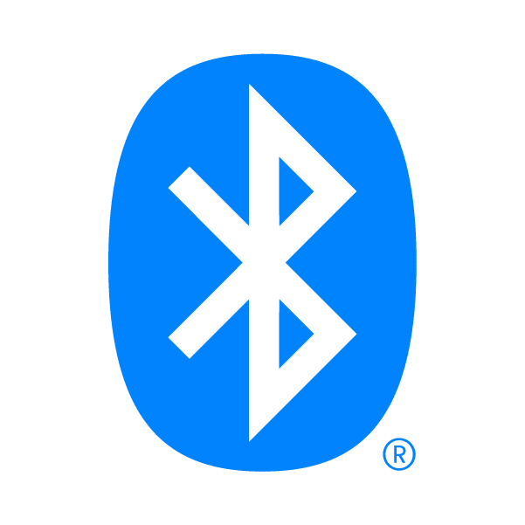
Overview
Communication protocol that facilitates the exchange of binary objects between devices
Maintained by Infrared Data Association, so it's also known as IrOBEX
Although it was first designed for infrared, it has been adopted by Bluetooth

Slide 3
OBEX vs HTTP
HTTP uses human-readable text, but OBEX uses binary-formatted type-length-value triplets
HTTP transactions are inherently stateless
HTTP client opens a connection
Makes a single request
Receives its response, and either closes the connection or makes other unrelated requests
In OBEX, a single transport connection may bear many related operations. In fact, recent additions to the OBEX specification allow an abruptly closed transaction to be resumed with all state information intact.

Slide 4
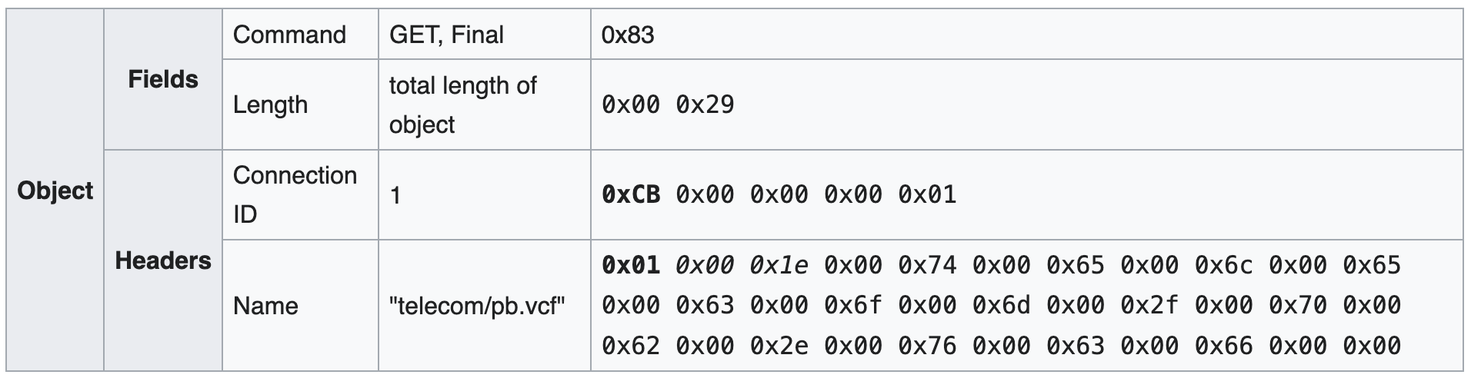
Request object

Slide 5
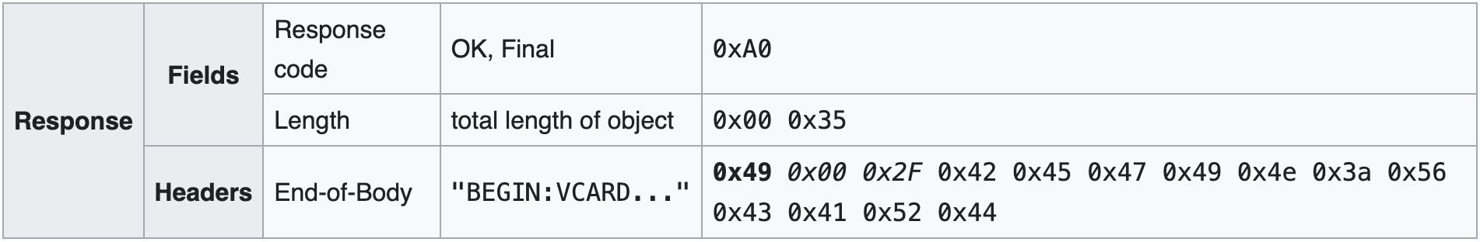
Response object

Slide 6
Session actions
CONNECT: one of the fields specifies the largest size of packets the client can receive; a TARGET header specifies the kind of service the client is expecting (file-browsing, sync-ml, phonebook access); the server answer with its maximal packet length, the connection id, and other data
GET: the client requests a file, specifying the connection id, the file name and/or its type; the server answer with the file content, or just a part of it; in the latter case, the client has to send other GET objects to obtain the rest of the file
SETPATH: the client tells the server to switch to a different file folder, specifying the connection id and the folder name in two headers
GET: the client requests a listing of the folder content by sending an object with the connection id and an appropriate TYPE header (e.g., "x-obex/folder-listing" for file transfer, "x-bt/vcard-listing" for phonebook access)
PUT: the client sends a file to the server; if it is too large to fit into a single packet, the server will request the next part with a CONTINUE response
DISCONNECT: the client informs the server that it is closing the session

Slide 7
Protocols
OBEX Phonebook Access Profile (PBAP)
OBEX Object Push Profile (OPP)
OBEX File Transfer Profile (FTP)
… and 2 others that are used as often
IrMC. Was designed for the exchange of phonebook entries, calendar entries, digital business cards, and to-do lists
SyncML. Can synchronize phonebooks, calendars, notes, and other data.

Slide 8
OBEX Phonebook Access Profile
Allows access to the phonebook, call log (ex. A car may request this)
You can
View contacts
Get details
Sync automatically contacts

Slide 9
OBEX Object Push Profile
Allows small file transfers
One use case is sending stuff like business cards, images
Also allows simple connections from any devices

Slide 10
OBEX File Transfer Profile
Allows browser-like capabilities, with whom you can transfer files
You can
List files and folders
Send/receive between devices
Create/rename or delete folders

Slide 11
PyOBEX demo

